Slide 1


REINFORCEMENT LEARNING
Learning Through Interaction
Sequential Decision Making
🎮 Game Playing | 🤖 Robotics
MDP, Q-Learning, DQN, Policy Gradient, Actor-Critic, Exploration
LEARN
APPLY
MASTER

Slide 2
Overview of the Core Algorithms
Markov Decision Process
Foundation, states, actions, rewards
Q-Learning
Learn Q-values, table-based, discrete
Deep Q-Network
Q-Learning + neural networks, high-dim
Policy Gradient
Optimize policy directly, continuous
Actor-Critic
Combine actor + critic, stable learning
Exploration vs Exploitation
Balance discovery and exploitation

Slide 3
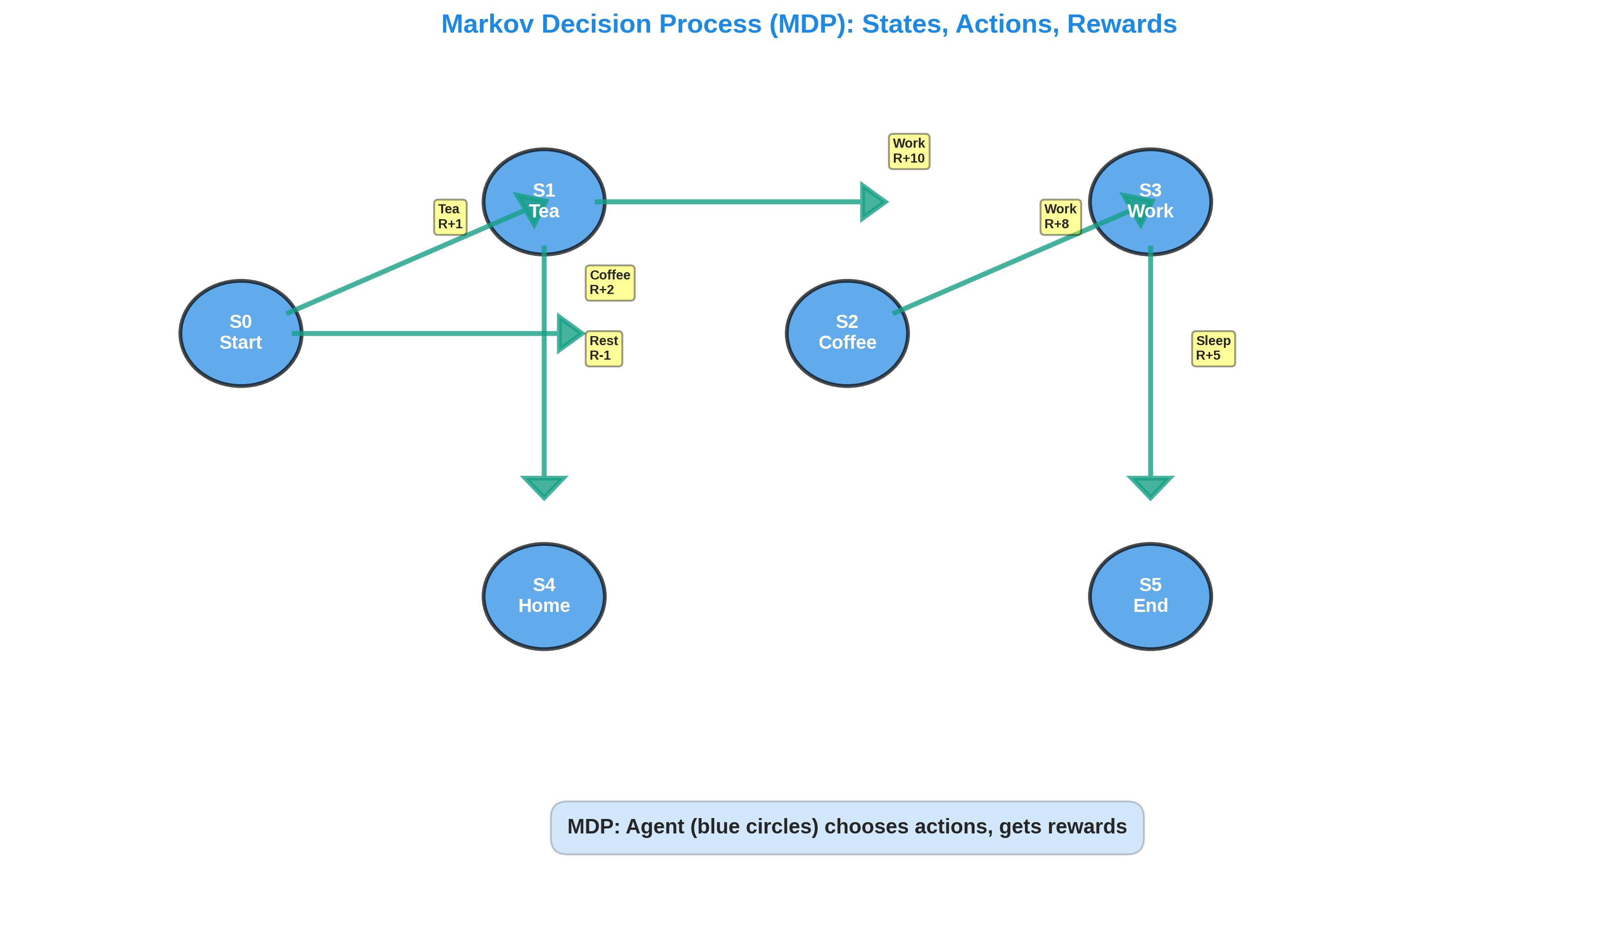
1. MDP - State Transition Diagram

Slide 4
1. MDP - Key Concepts
Core Elements
State (S): Description of situation
Action (A): Agent decides
Reward (R): Feedback signal
Policy (π): State → Action
Value (V): Expected reward
Q-value: Q(s,a) value of action
Applications
• Chess, Go (AlphaGo)
• Atari games
• Robotics control
• Autonomous driving
• Trading bots
• Recommendation engines

Slide 5
1. MDP - Summary
Agent: Learns by interaction with environment
Goal: Maximize cumulative reward over time
Components: States, Actions, Rewards, Transitions
Policy: Function mapping states to actions
Trajectory: Sequence of S → A → R transitions
Code: from gymnasium import Env (OpenAI Gym)

Slide 6
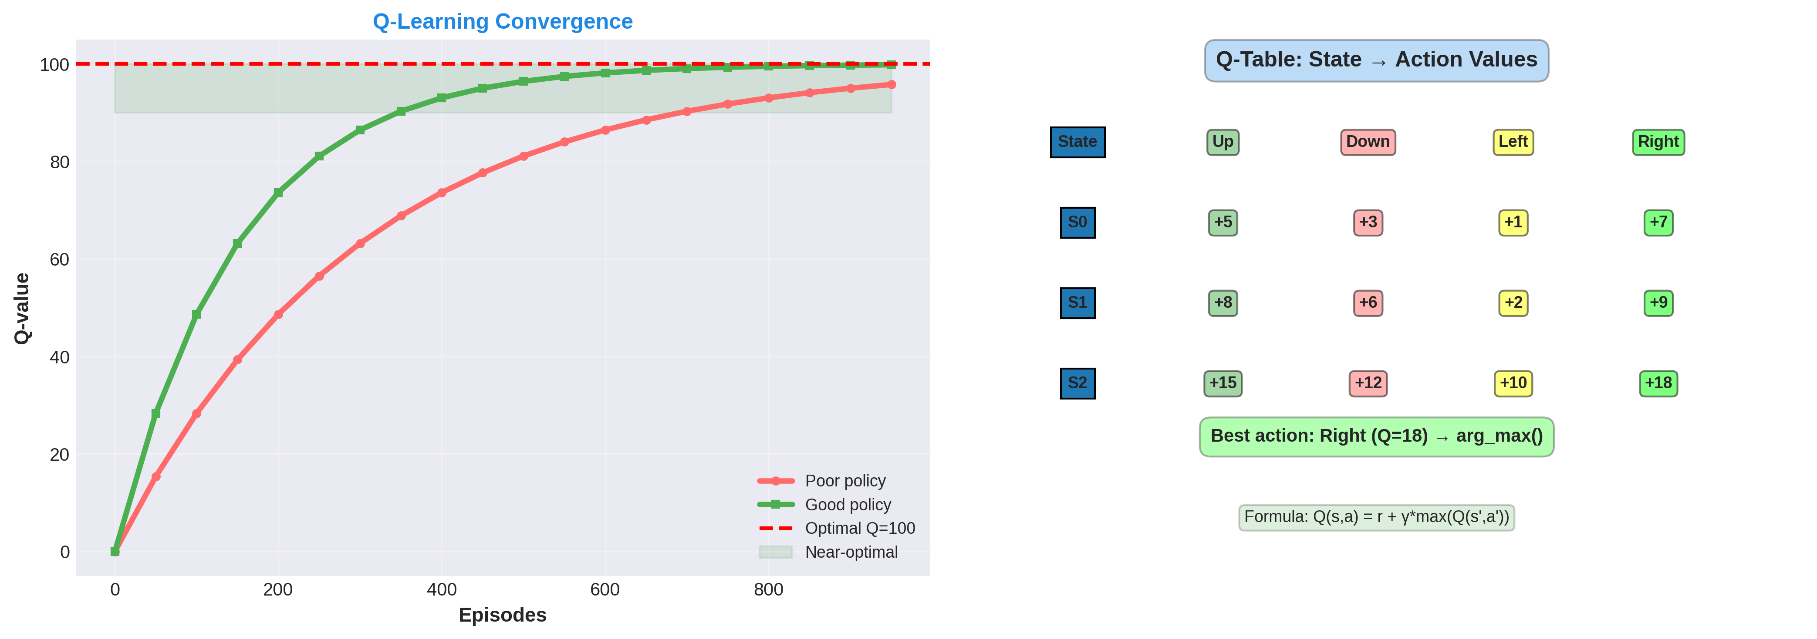
2. Q-Learning - Convergence & Q-Table

Slide 7
2. Q-Learning - Pros & Cons
Advantages
✓ Simple, interpretable
✓ Off-policy learning
✓ Guaranteed to converge
✓ Low computation
✓ Works offline
Limitations
✗ Only discrete spaces
✗ Q-table scales poorly
✗ 10×10 grid = 10^20 states!
✗ Can't handle images
✗ Slow for large spaces

Slide 8
2. Q-Learning - Summary
Type: Value-based, off-policy, model-free
Output: Q-table: S×A matrix of values
Algorithm: Iterative Q-value updates
Best For: Small discrete problems
Code: from stable_baselines3 import QLearning

Slide 9
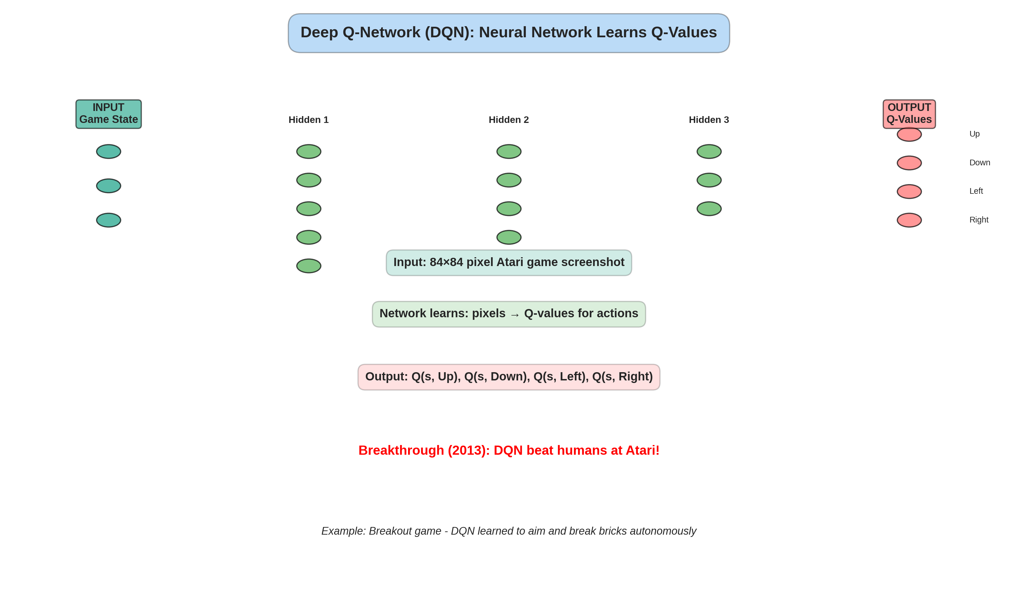
3. DQN - Neural Network Architecture

Slide 10
3. DQN - Key Innovations
Experience Replay
Store transitions in buffer
Sample mini-batches randomly
Reduces correlation in data
Improves sample efficiency
Target Network
Separate stable target Q
Update every N steps
Prevents divergence
More stable training

Slide 11
3. DQN - Summary
Type: Value-based, deep RL, CNN + Q-learning
Input: High-dimensional: pixels, sensor data
Output: Q-value for each action
Best For: Visual tasks, complex games, continuous control
Code: from stable_baselines3 import DQN

Slide 12
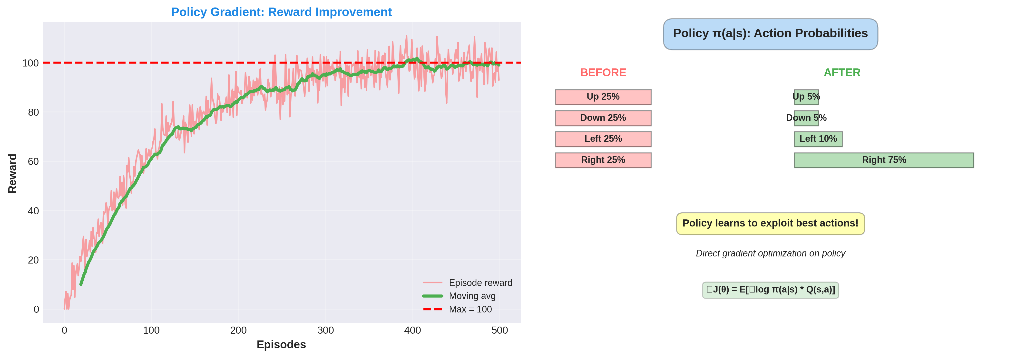
4. Policy Gradient - Learning Curve

Slide 13
4. Policy Gradient - Algorithms
REINFORCE
Basic policy gradient
High variance
Simple but slow
Good for learning
PPO (Recommended)
Proximal Policy Optimization
Stable, efficient
Industry standard
State-of-the-art results

Slide 14
4. Policy Gradient - Summary
Type: Policy-based, on-policy, model-free
Output: Probability distribution over actions
Best For: Continuous action spaces, robotic control
Variants: REINFORCE, TRPO, PPO, A3C
Code: from stable_baselines3 import PPO

Slide 15
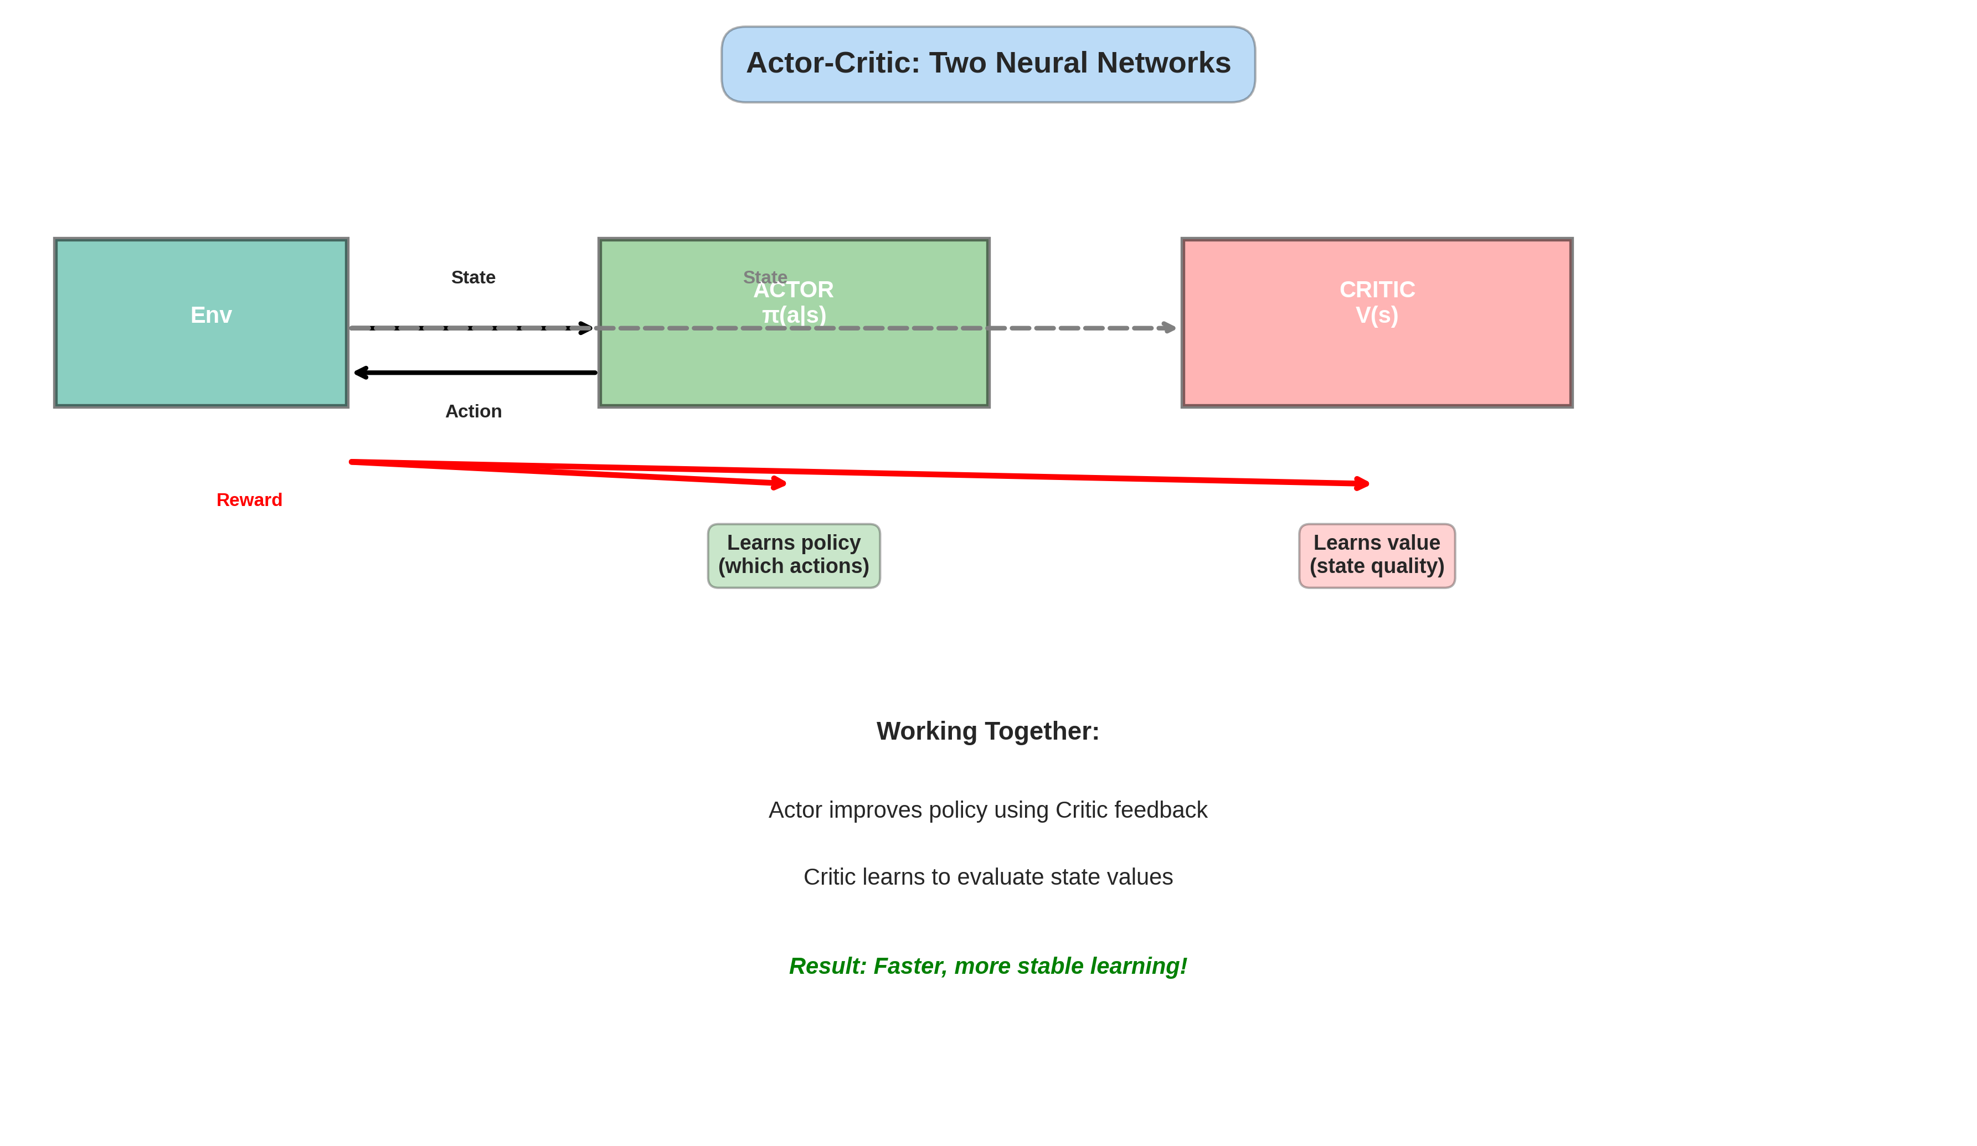
5. Actor-Critic - Architecture

Slide 16
5. Actor-Critic - Methods
A3C (Distributed)
Asynchronous advantage actor-critic
Parallel workers
Fast training
Handles discrete+continuous
DDPG (Continuous)
Deep deterministic policy gradient
Off-policy learning
Continuous actions
Used in robotics

Slide 17
5. Actor-Critic - Summary
Type: Hybrid: combines value + policy methods
Actor: Policy network π(a|s)
Critic: Value network V(s)
Best For: Most practical applications, stable learning
Variants: A3C, A2C, DDPG, TD3, SAC
Code: from stable_baselines3 import A2C

Slide 18
6. Exploration vs Exploitation
The Dilemma
Explore: Try new actions
Exploit: Use best known action
Explore too much: Waste time
Exploit too much: Miss better
options
Solution: ε-Greedy
Start explore, gradually exploit
Strategies
• ε-Greedy: random + best
• Softmax: probability-weighted
• UCB: upper confidence bound
• Thompson sampling: Bayesian
• Entropy bonus: encourage variety
Common: Start ε=1, decay to 0.1

Slide 19
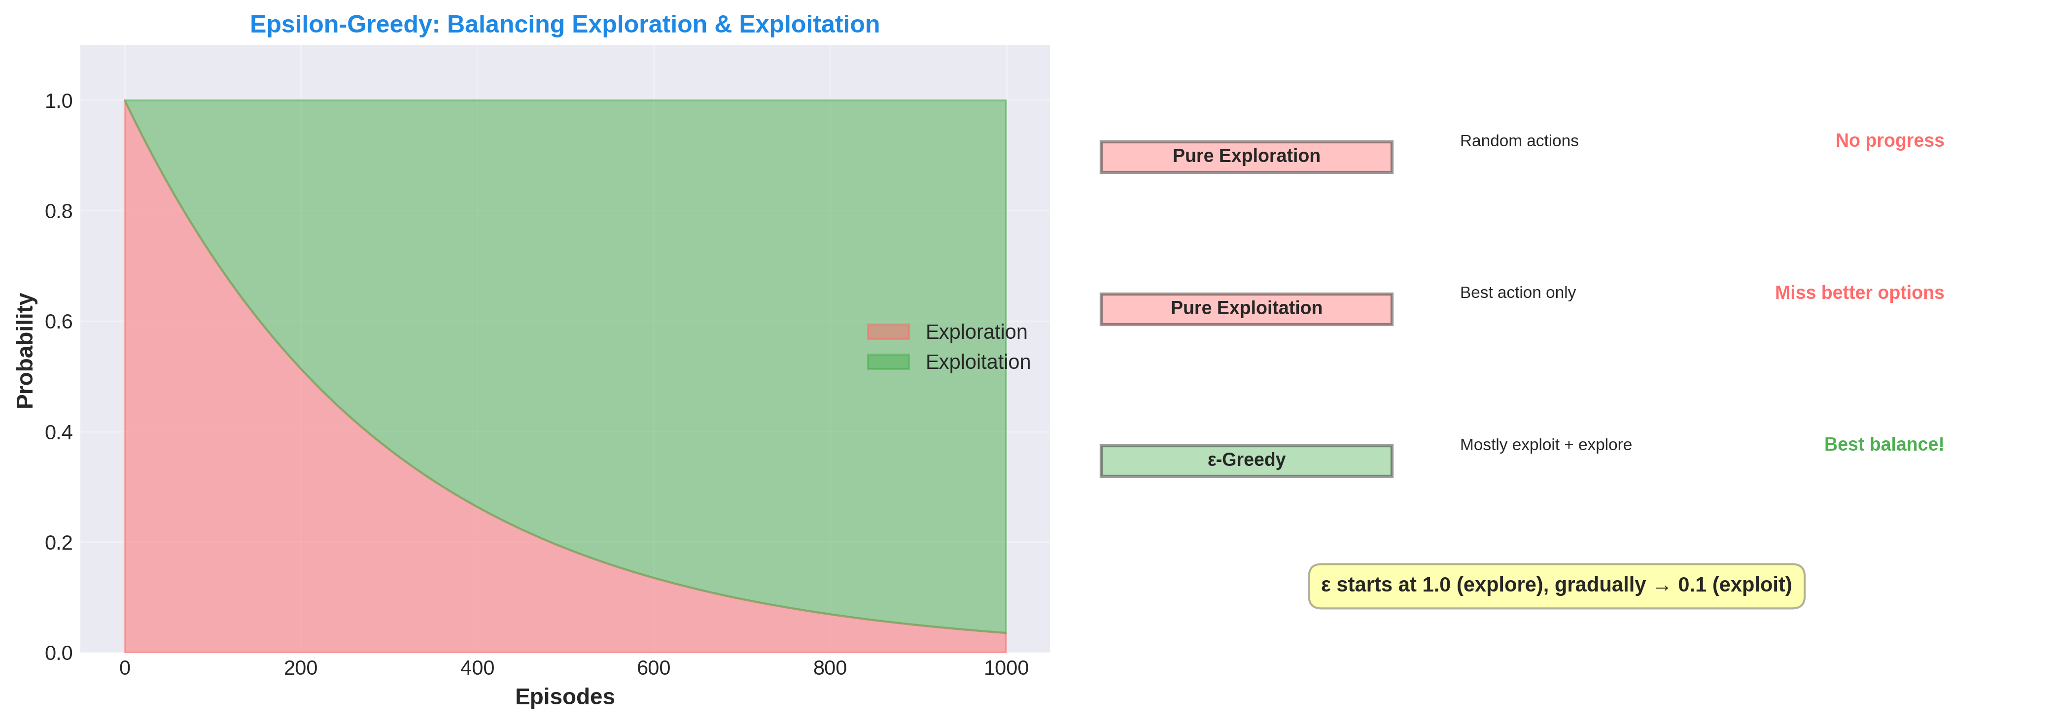
6. Exploration - Epsilon Decay & Strategies

Slide 20
6. Exploration - Key Takeaway
ε-Greedy Decay
Start: ε = 1.0 (100% explore)
Decay: ε = ε * decay_rate
End: ε = 0.1 (10% explore)
Example:
Episodes 1-100: Try random
Episodes 101-500: Mostly exploit
Episodes 501+: 90% exploit
Best Practices
• Start with high exploration
• Decay gradually over time
• Don't go to 0% exploration
• Keep 1-10% exploration always
• Tune decay rate for domain
Results: Better convergence!

Slide 21
Algorithm Comparison: When to Use Each
MDP → Foundation concept → Start here
Q-Learning → Small discrete spaces → Grid worlds
DQN → Visual/high-dim, discrete → Atari games
Policy Grad → Continuous actions → Robotics
Actor-Critic → Any problem, most stable → Recommended!
Exploration → Balance learn/exploit → All algorithms

Slide 22
RL Applications & Future
Games: AlphaGo, Dota 2, StarCraft II (superhuman)
Robotics: Boston Dynamics dogs, manipulation tasks
Autonomous: Self-driving cars, vehicle control
Trading: Algorithmic stock trading, portfolio optimization
Healthcare: Drug discovery, treatment planning
NLP: Language models, dialogue systems

